Slide 1
Experimental Plan
Objective: To evaluate the effectiveness hose streams for exterior offensive structural firefighting
Approach: Real scale, instrumented fire suppression experiments.
Key issues
Ventilation and flow paths
Gas Cooling
Suppression
Model validation data

Slide 2
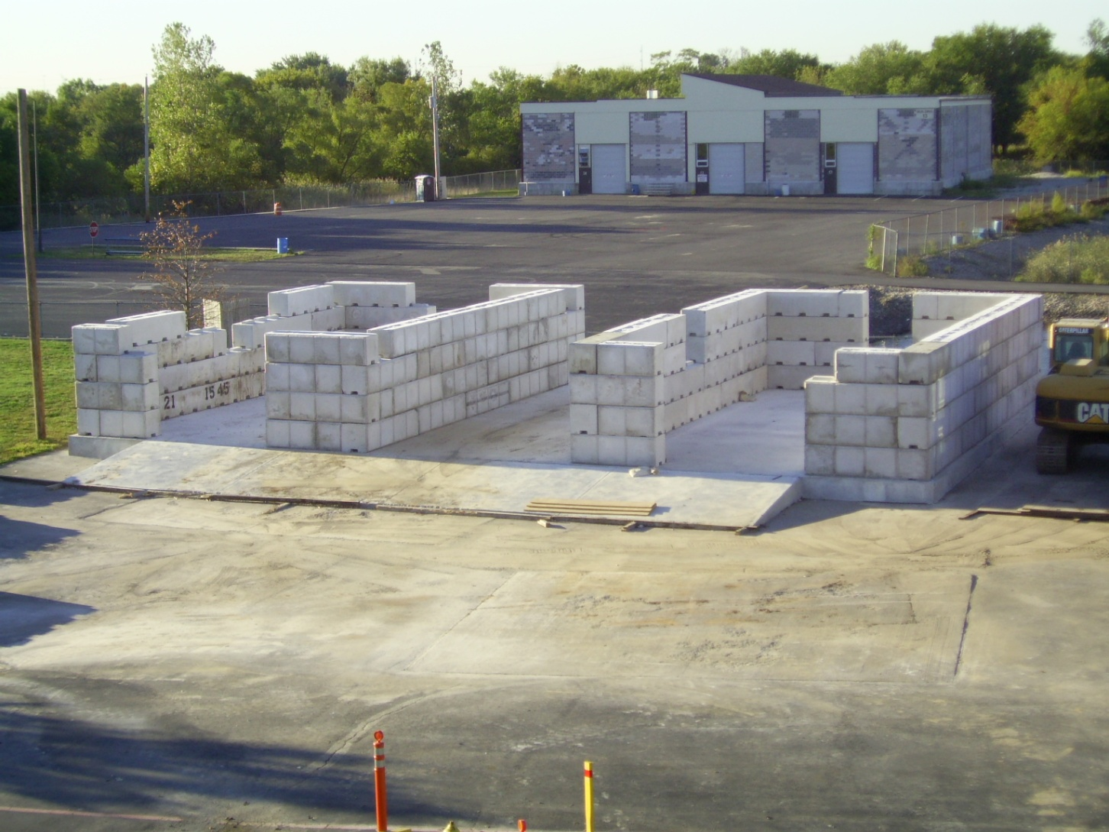
Delaware County (PA) Emergency Services Training Center

Slide 3
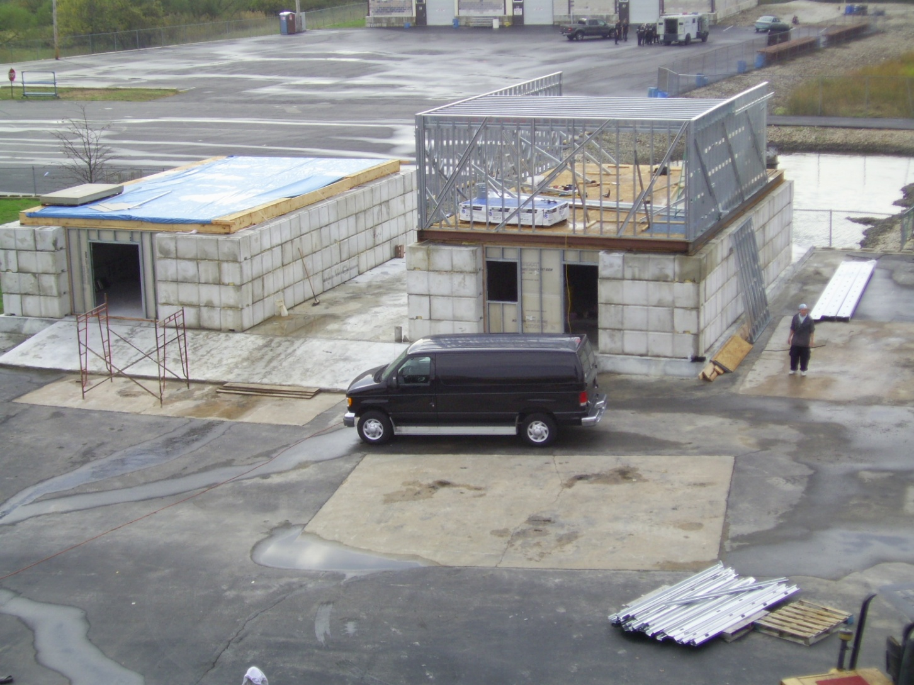

Slide 4
Potential Arrangement

Slide 5
Potential Arrangement

Slide 6
Potential Arrangement

Slide 7
Instrumentation
Thermocouples
Total Heat Flux Sensors
Radiometers
Bi-Directional Probes
IR Video
Video
Water/foam flow rate

Slide 8
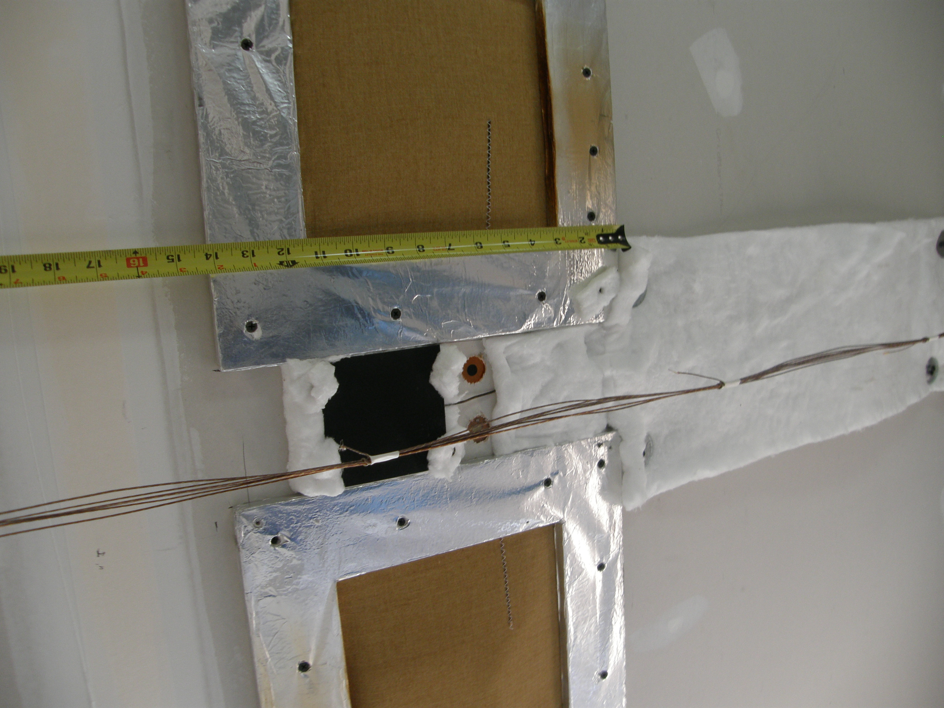
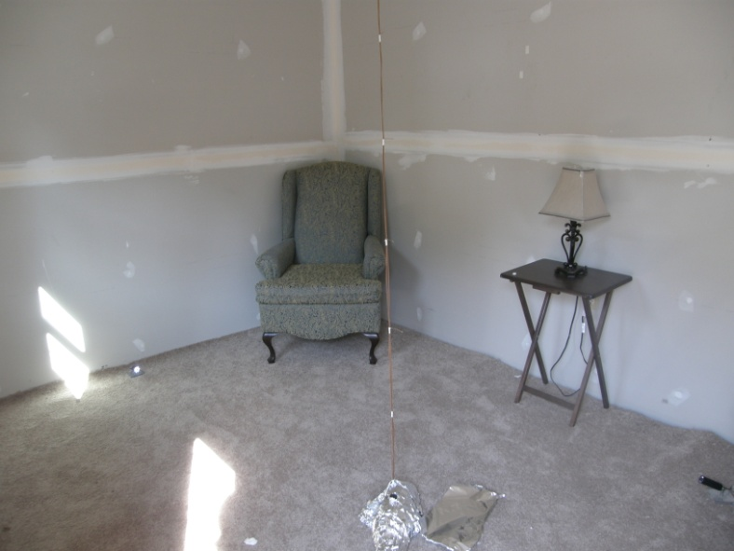
Thermocouples
Used to estimated the gas temperature
Once they get wet, they may no longer be providing data about the gas temperature
Potential Approaches
Two sets – Bare bead – exposed and bare bead covered with a shield to protect from direct liquid contact
Two sets – one measuring to the point of suppression, insert another after suppression

Slide 9
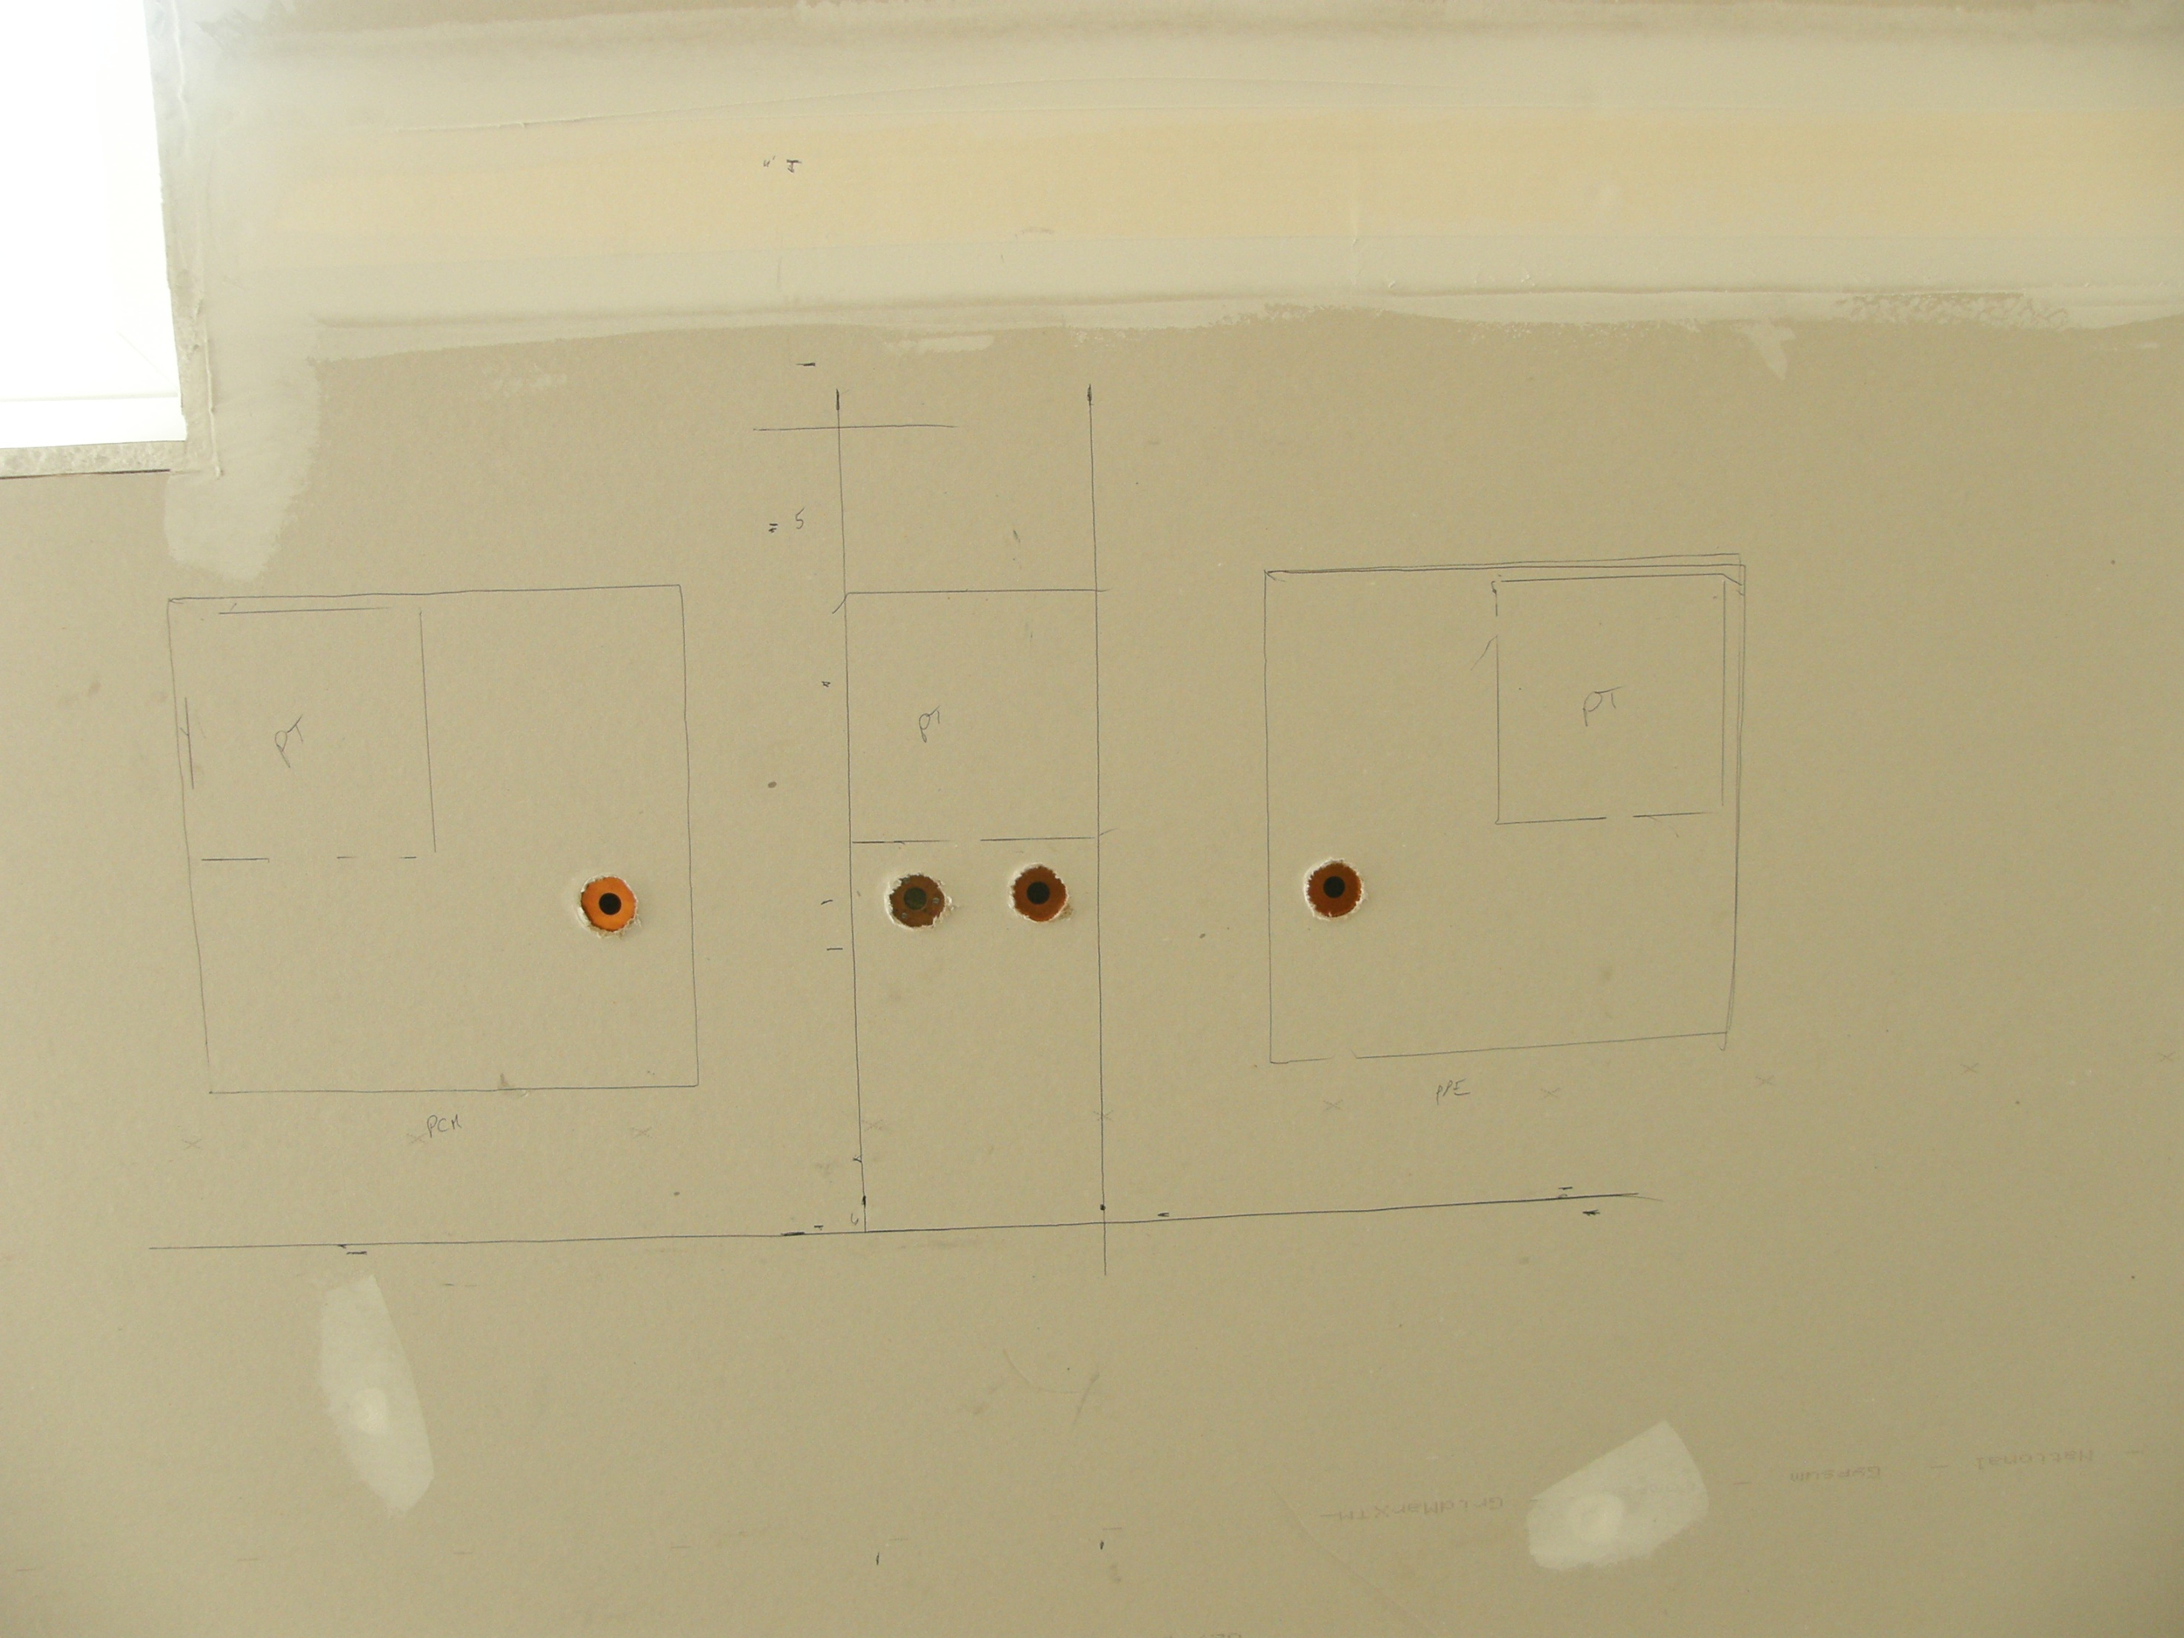
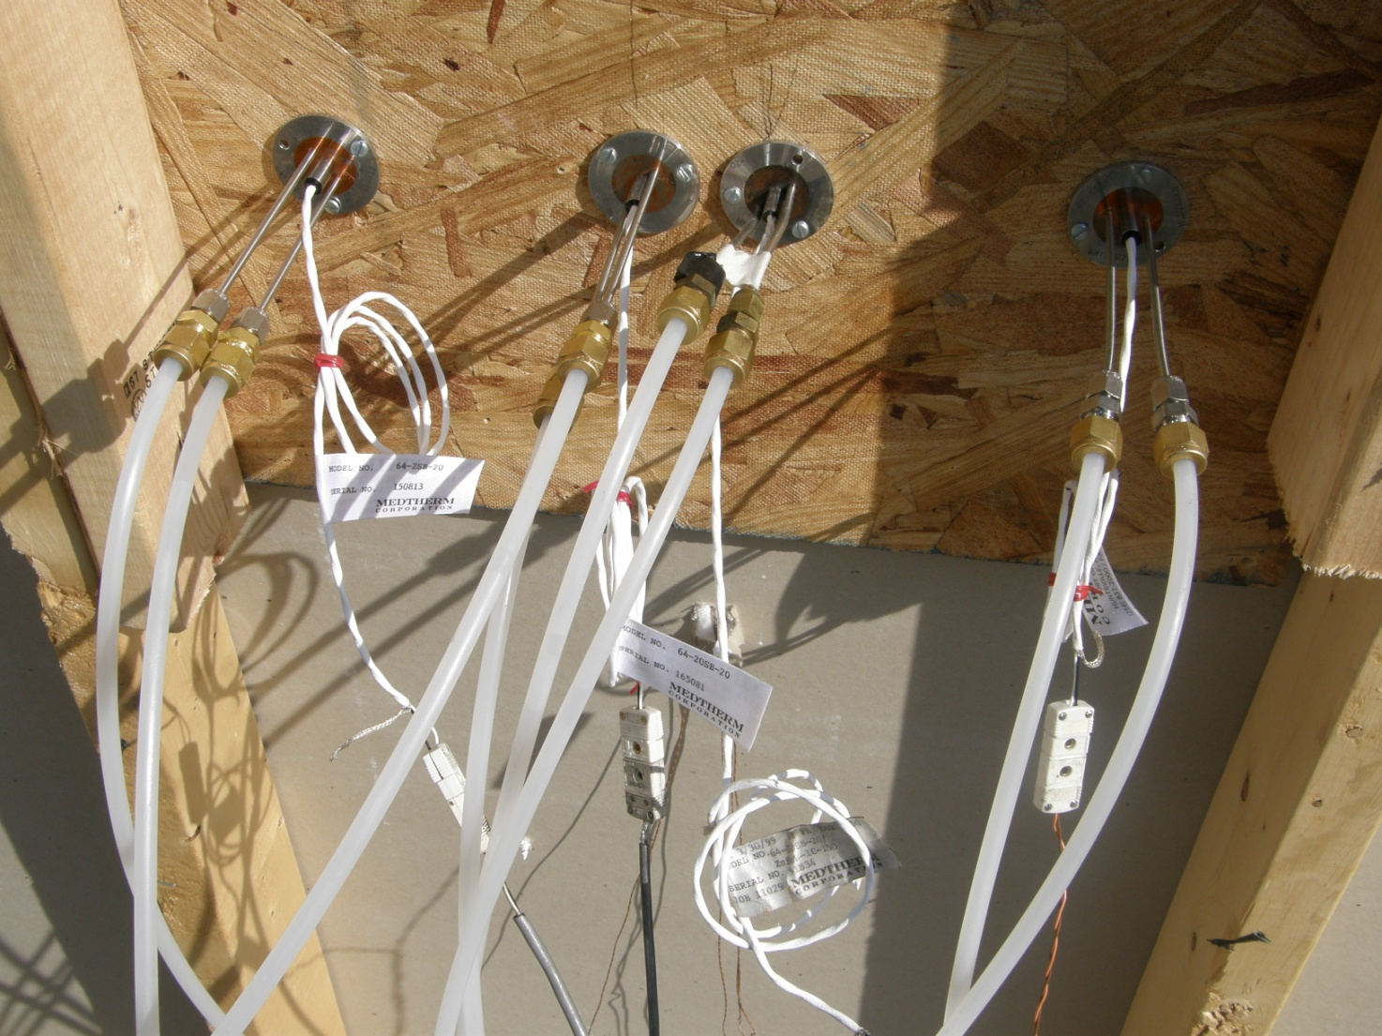
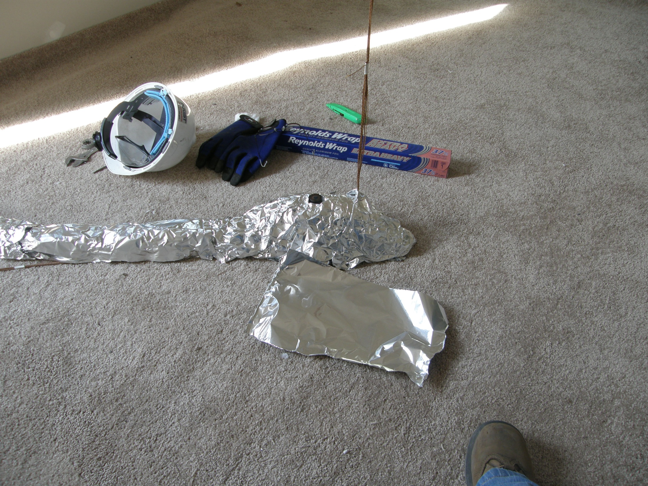
Total Heat Flux & Radiometers
Used to measure the rate of energy transfer in to the surface of the sensor
May be used to monitor the energy from the fire/compartment
Used in pairs can assess convective vs radiative heat transfer components
If covered with water or foam limited value of resulting post suppression data.

Slide 10
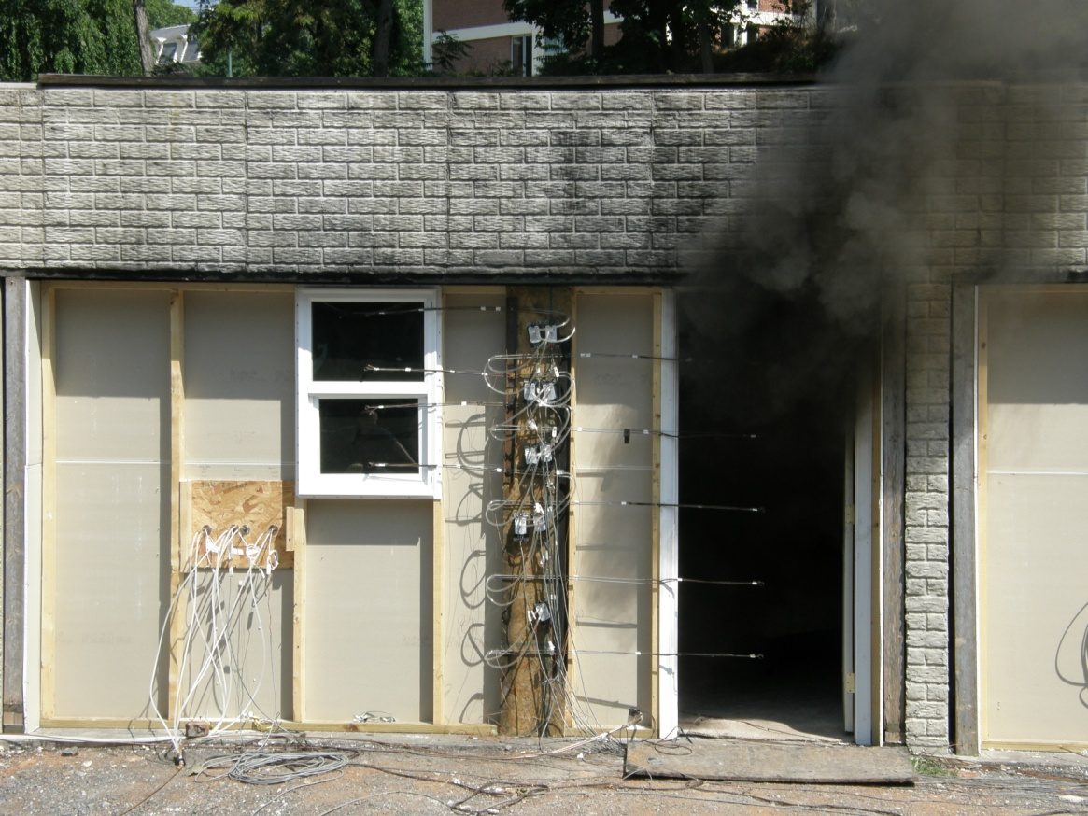
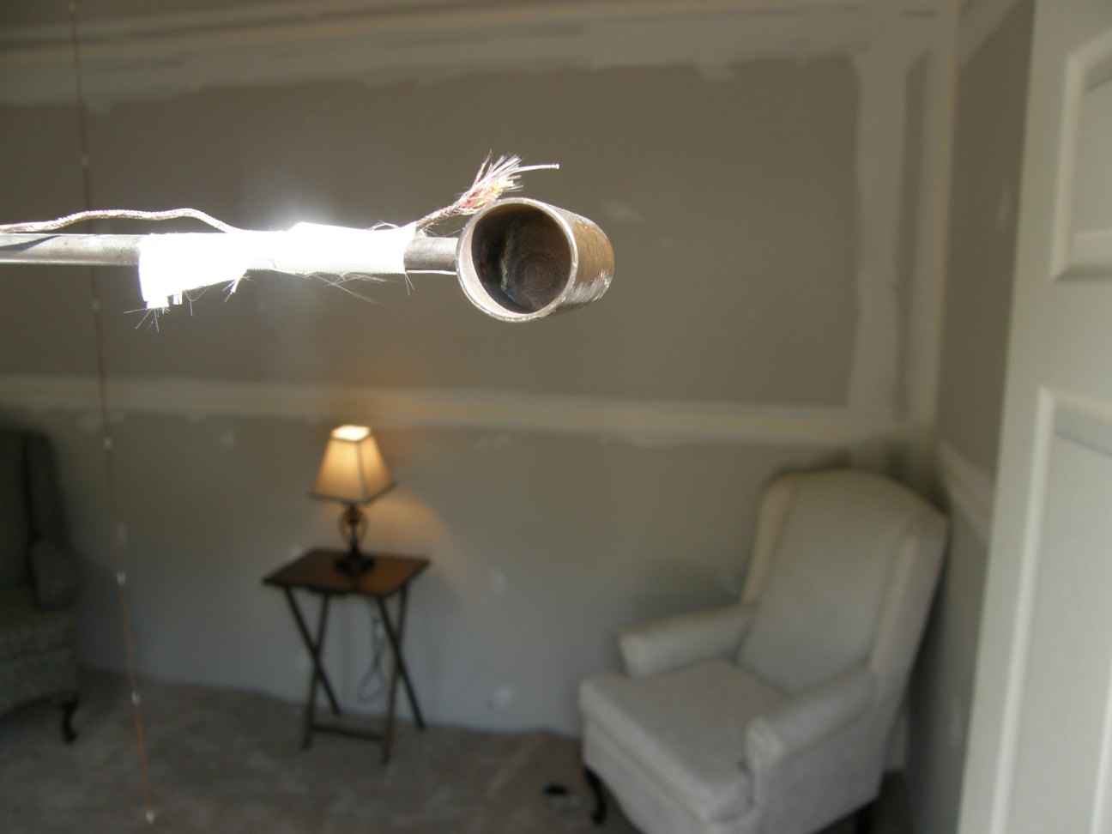
Bi-Directional Probes
Used to determine direction and speed of gas flows.
Rely on a differential pressure sensor and a thermocouple.
Moisture adversely affects measurement.
Water in the pressure tubes – no measurement

Slide 11
Infrared Video
Can be used to “see” thermal flows
Can be used post test to record energy emission from ceilings, walls and floors within the test structure, post suppression
Can be used post suppression to record energy emission from fuel package

Slide 12
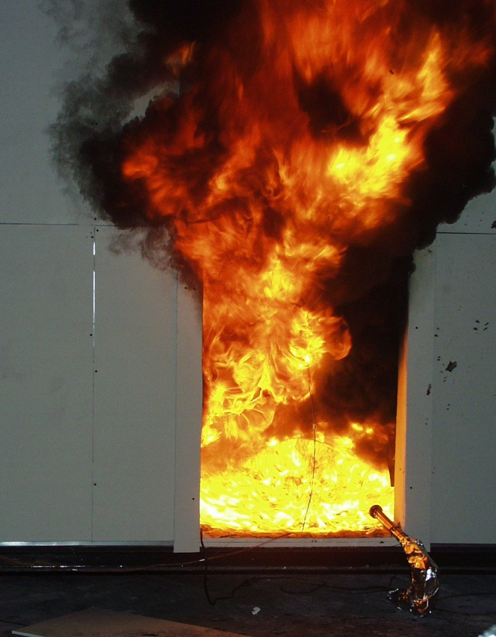
Video
Multiple cameras used to document experiments.
Used to confirm experimental timeline and events during experiment.
Line of sight needed.

Slide 13
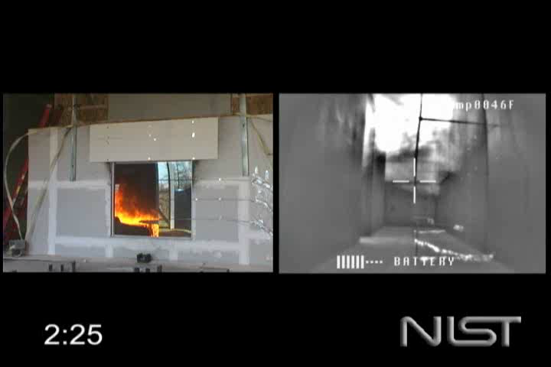
Video - IR Examples

Slide 14
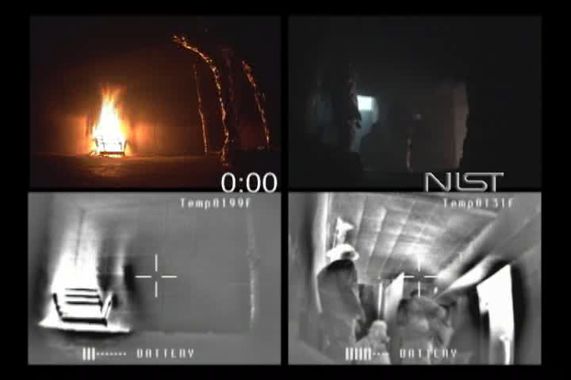

Slide 15
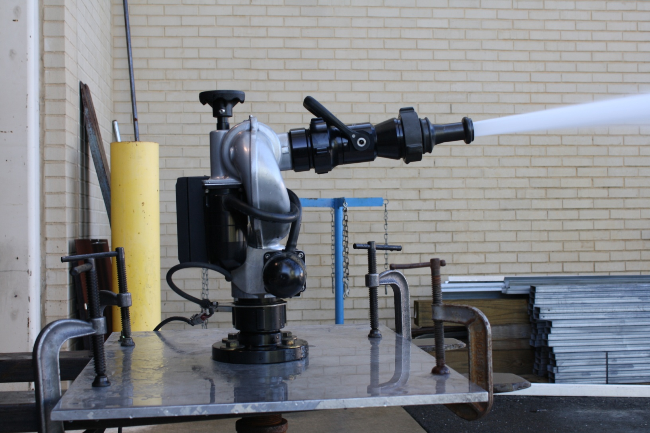
Remote Control Monitor

Slide 16
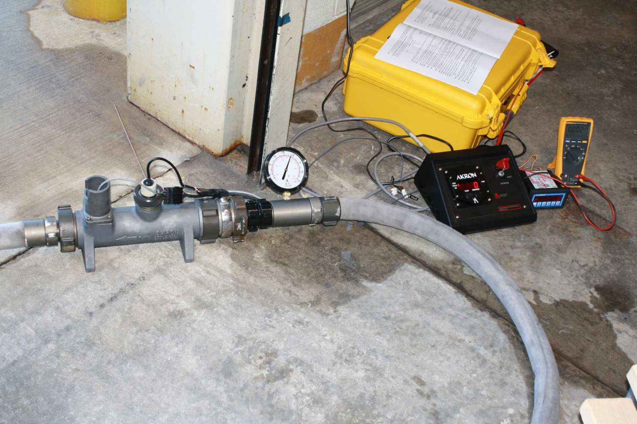
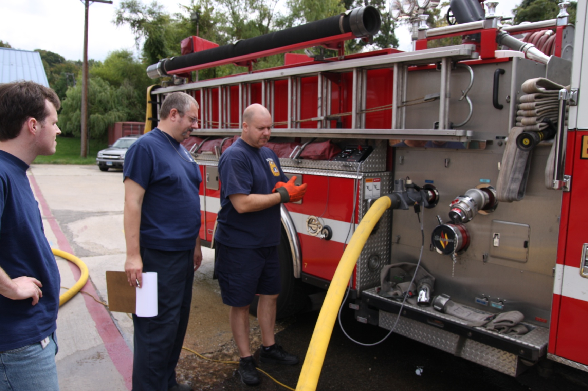
Water Flow Rate

Slide 17
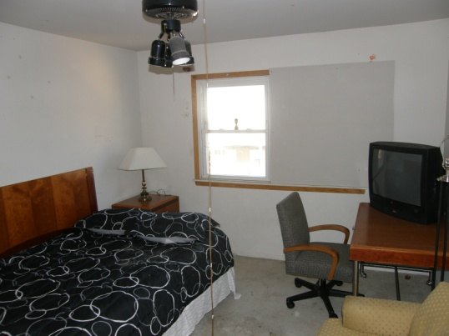
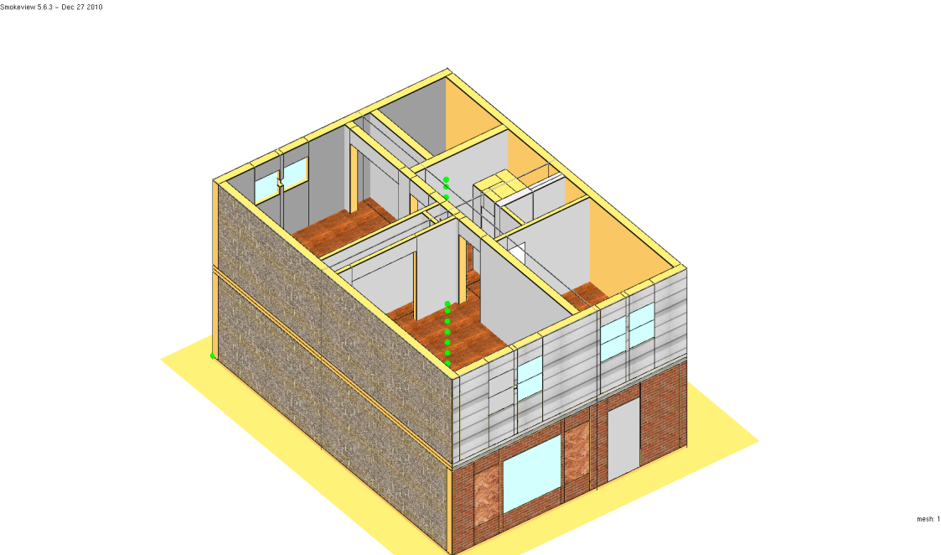
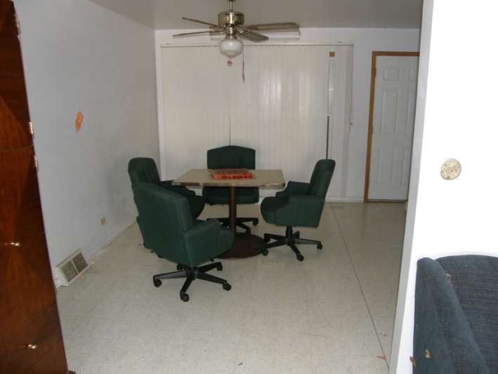
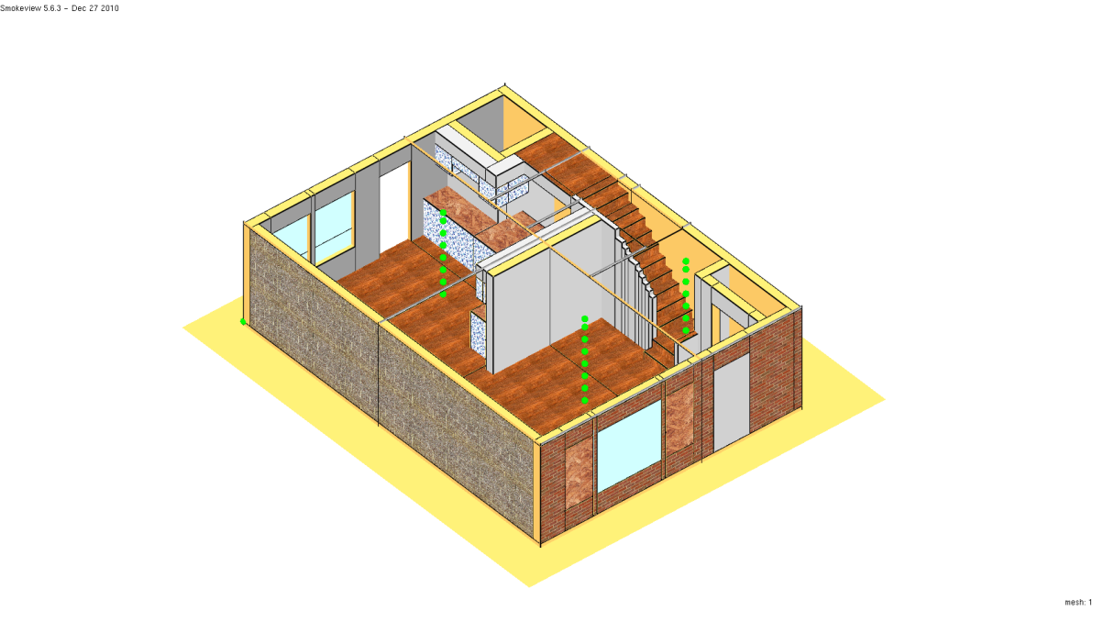
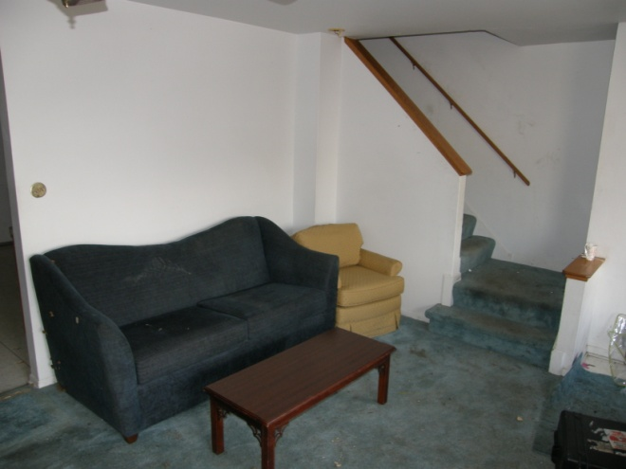
Townhouse Fire

Slide 18
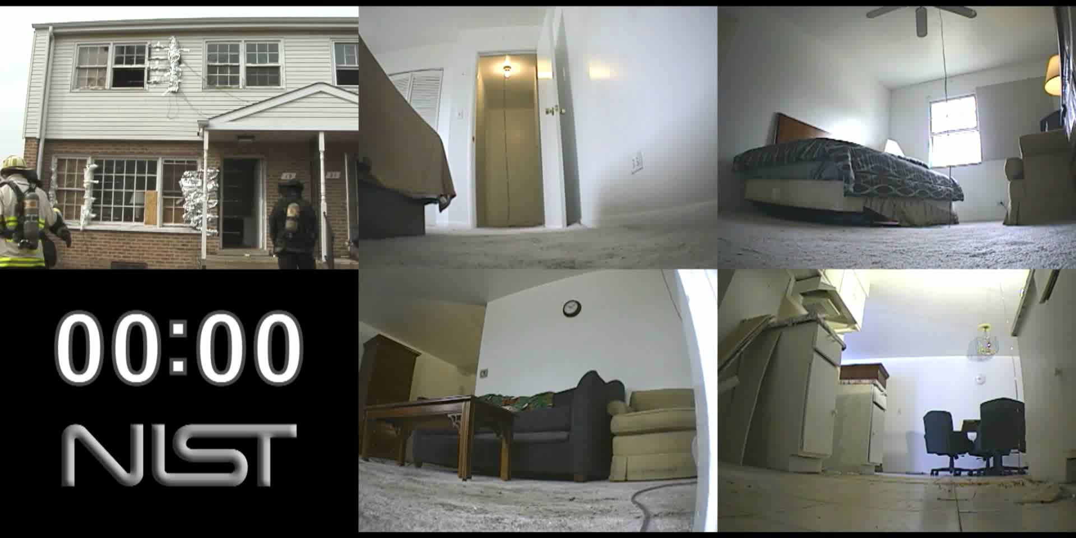

Slide 19
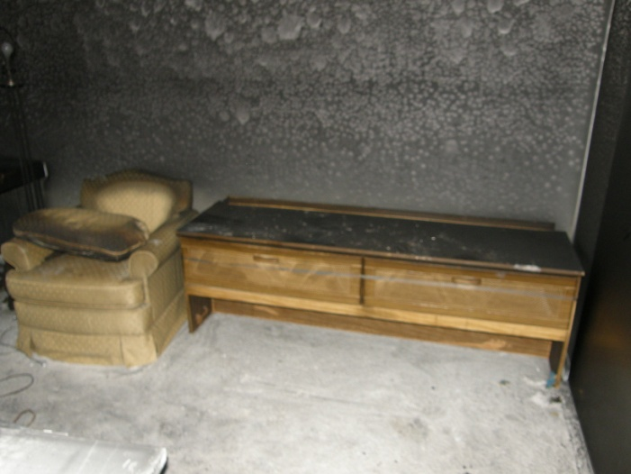
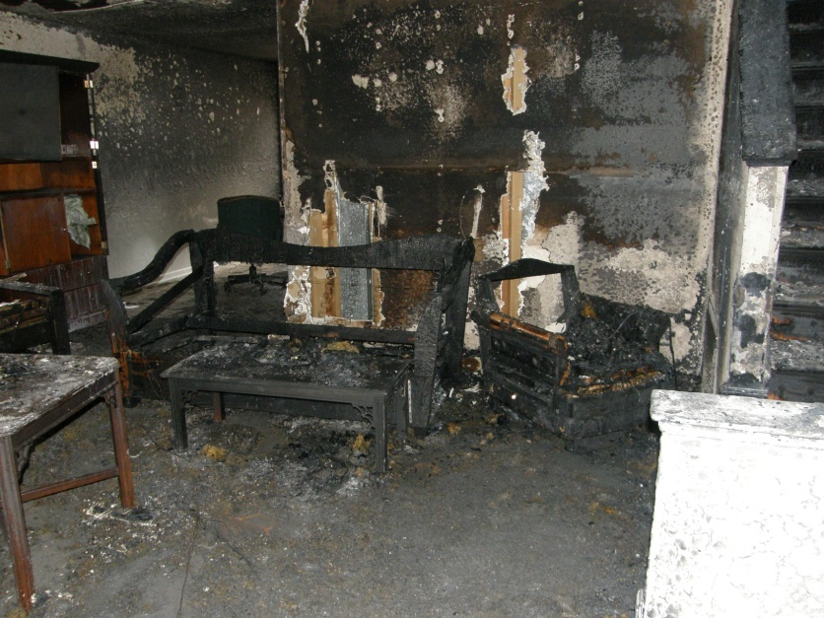
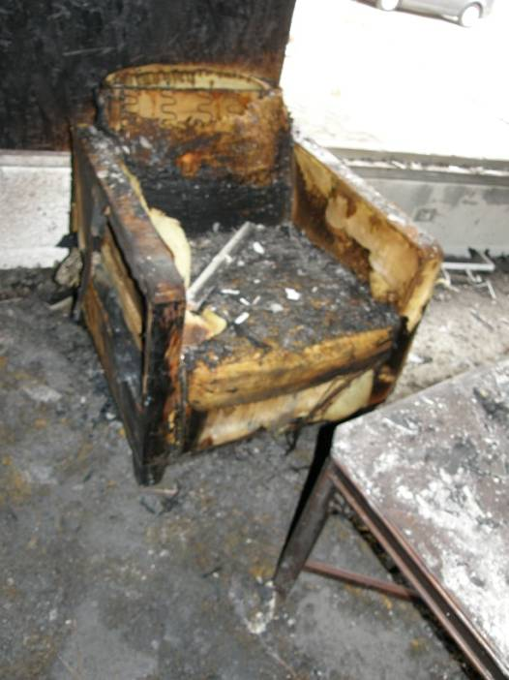
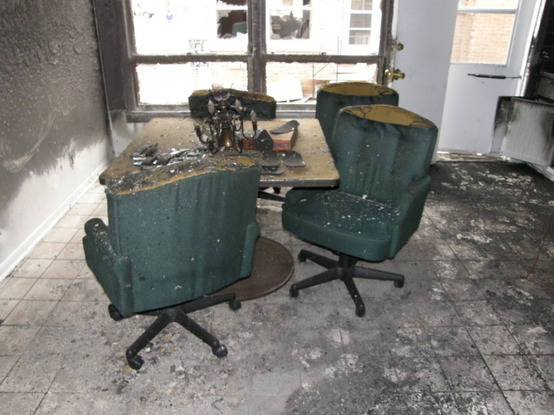
Post Fire

Slide 20
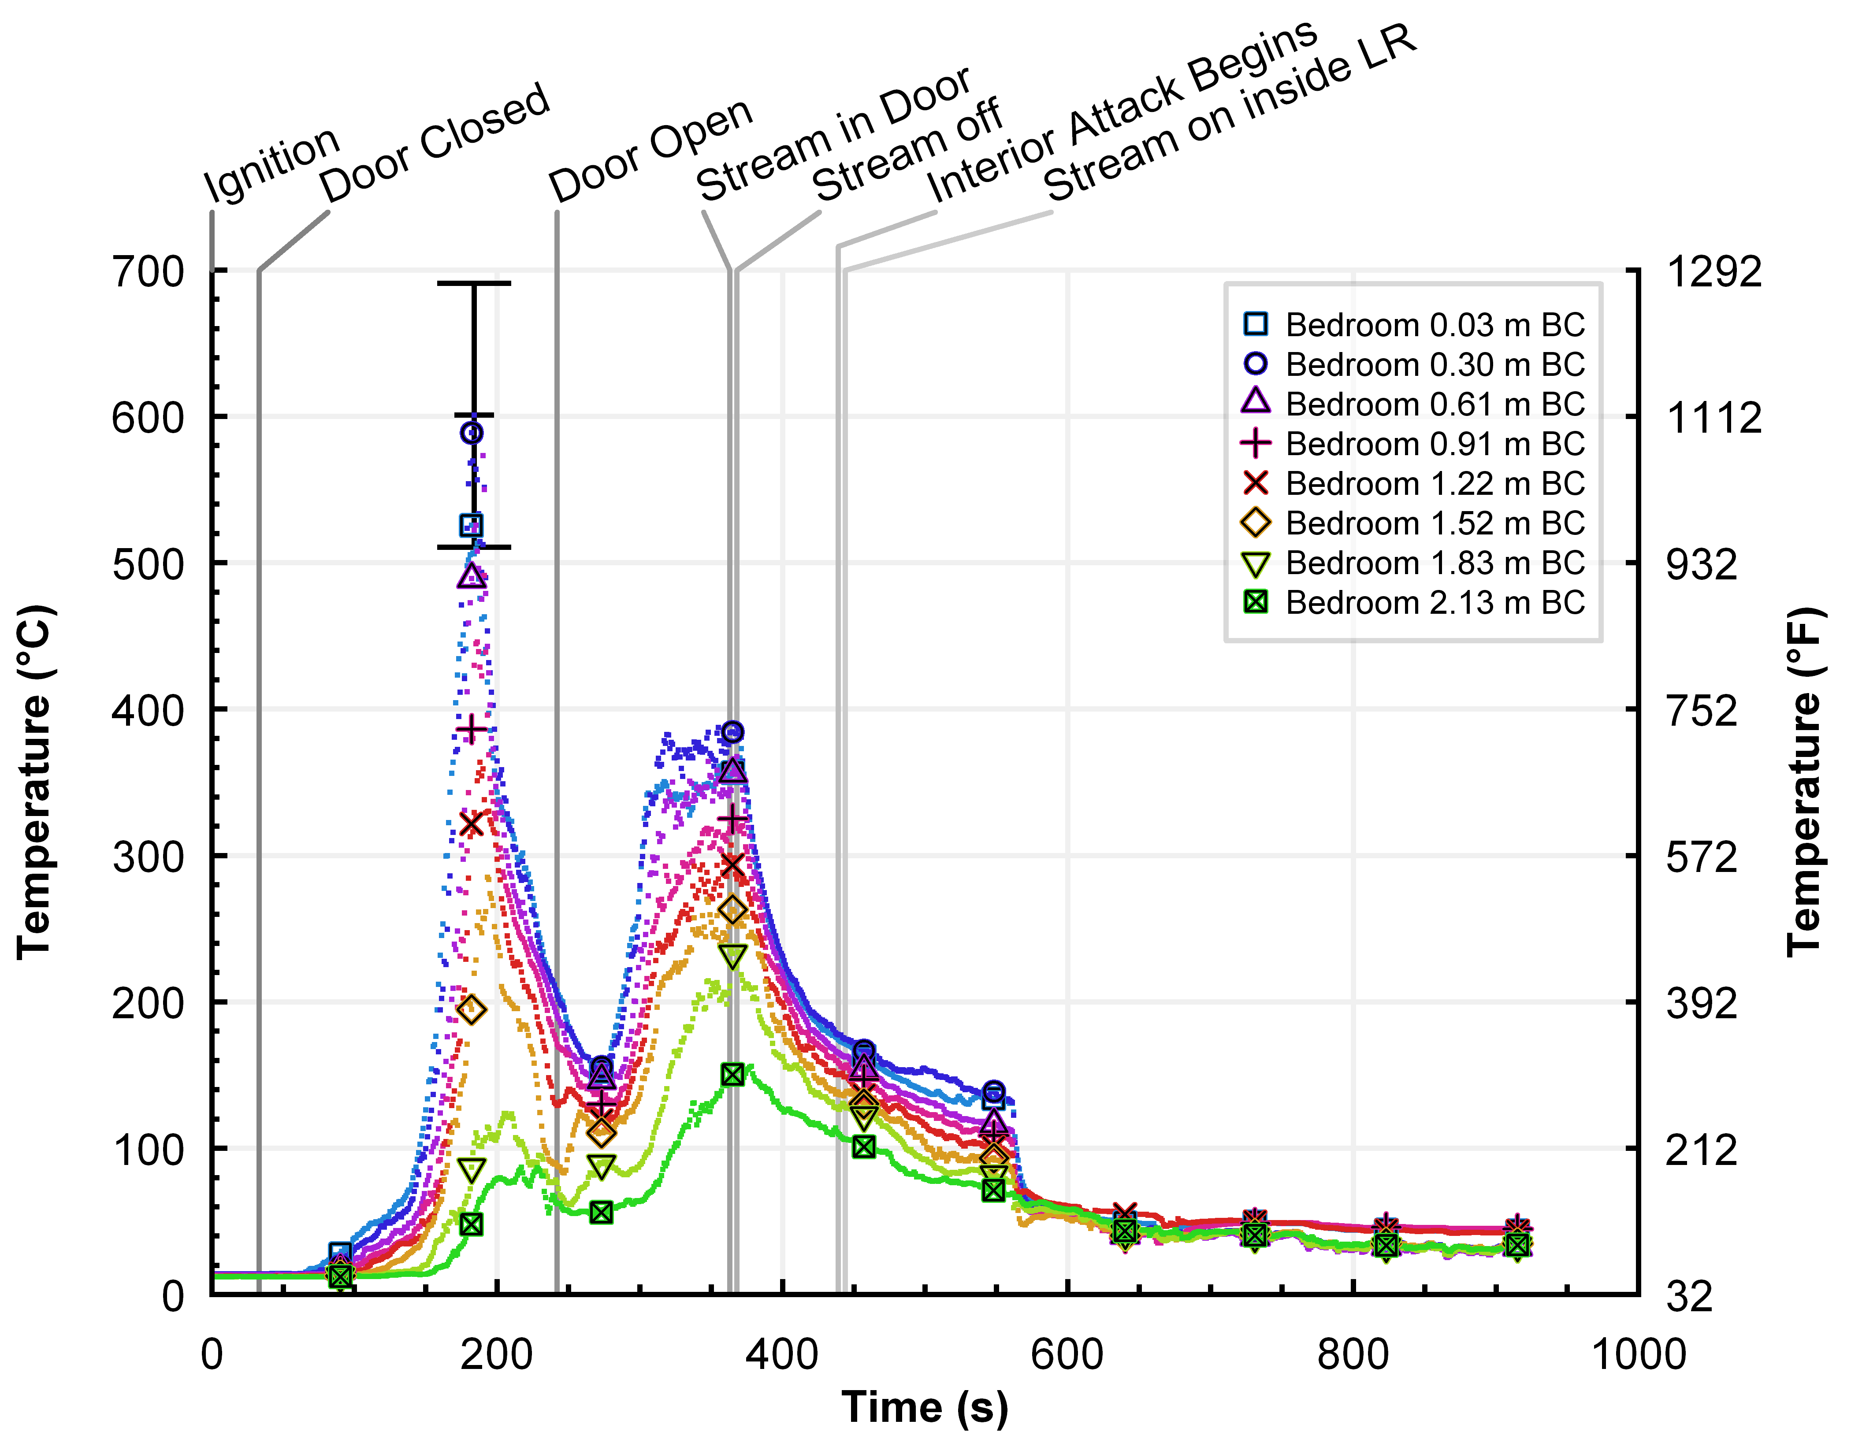
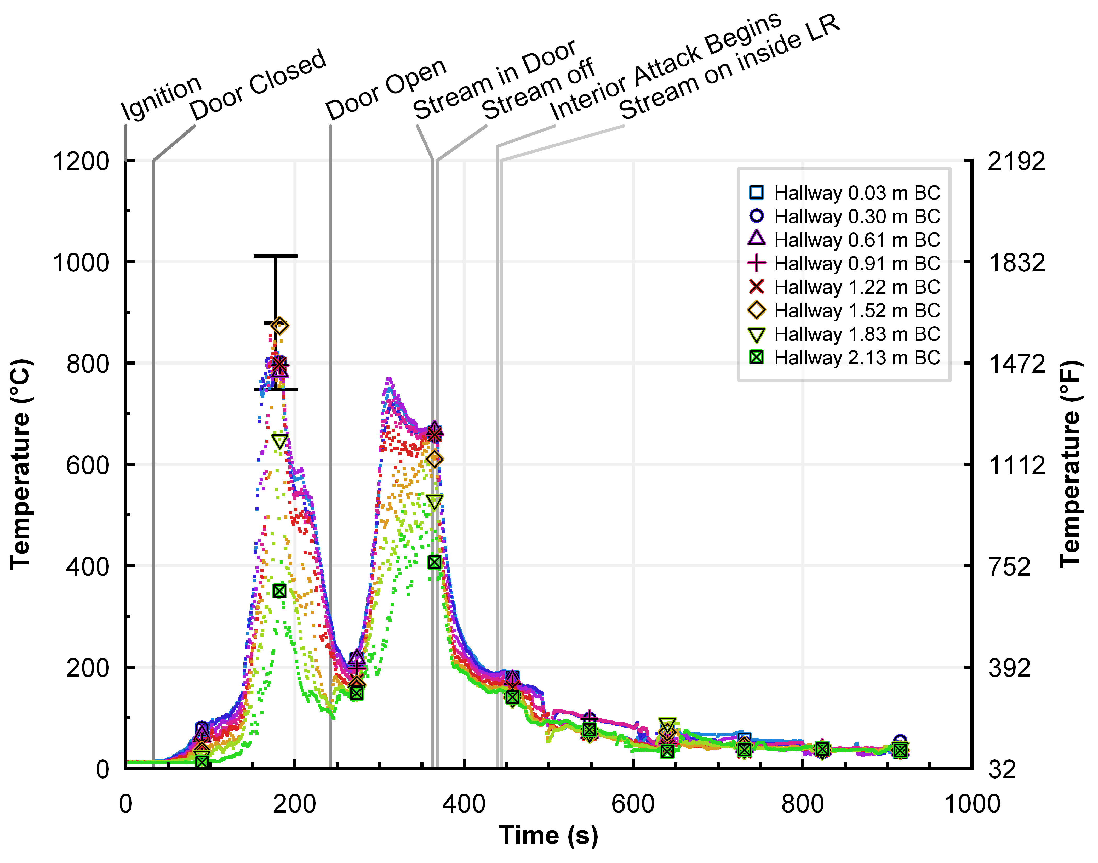
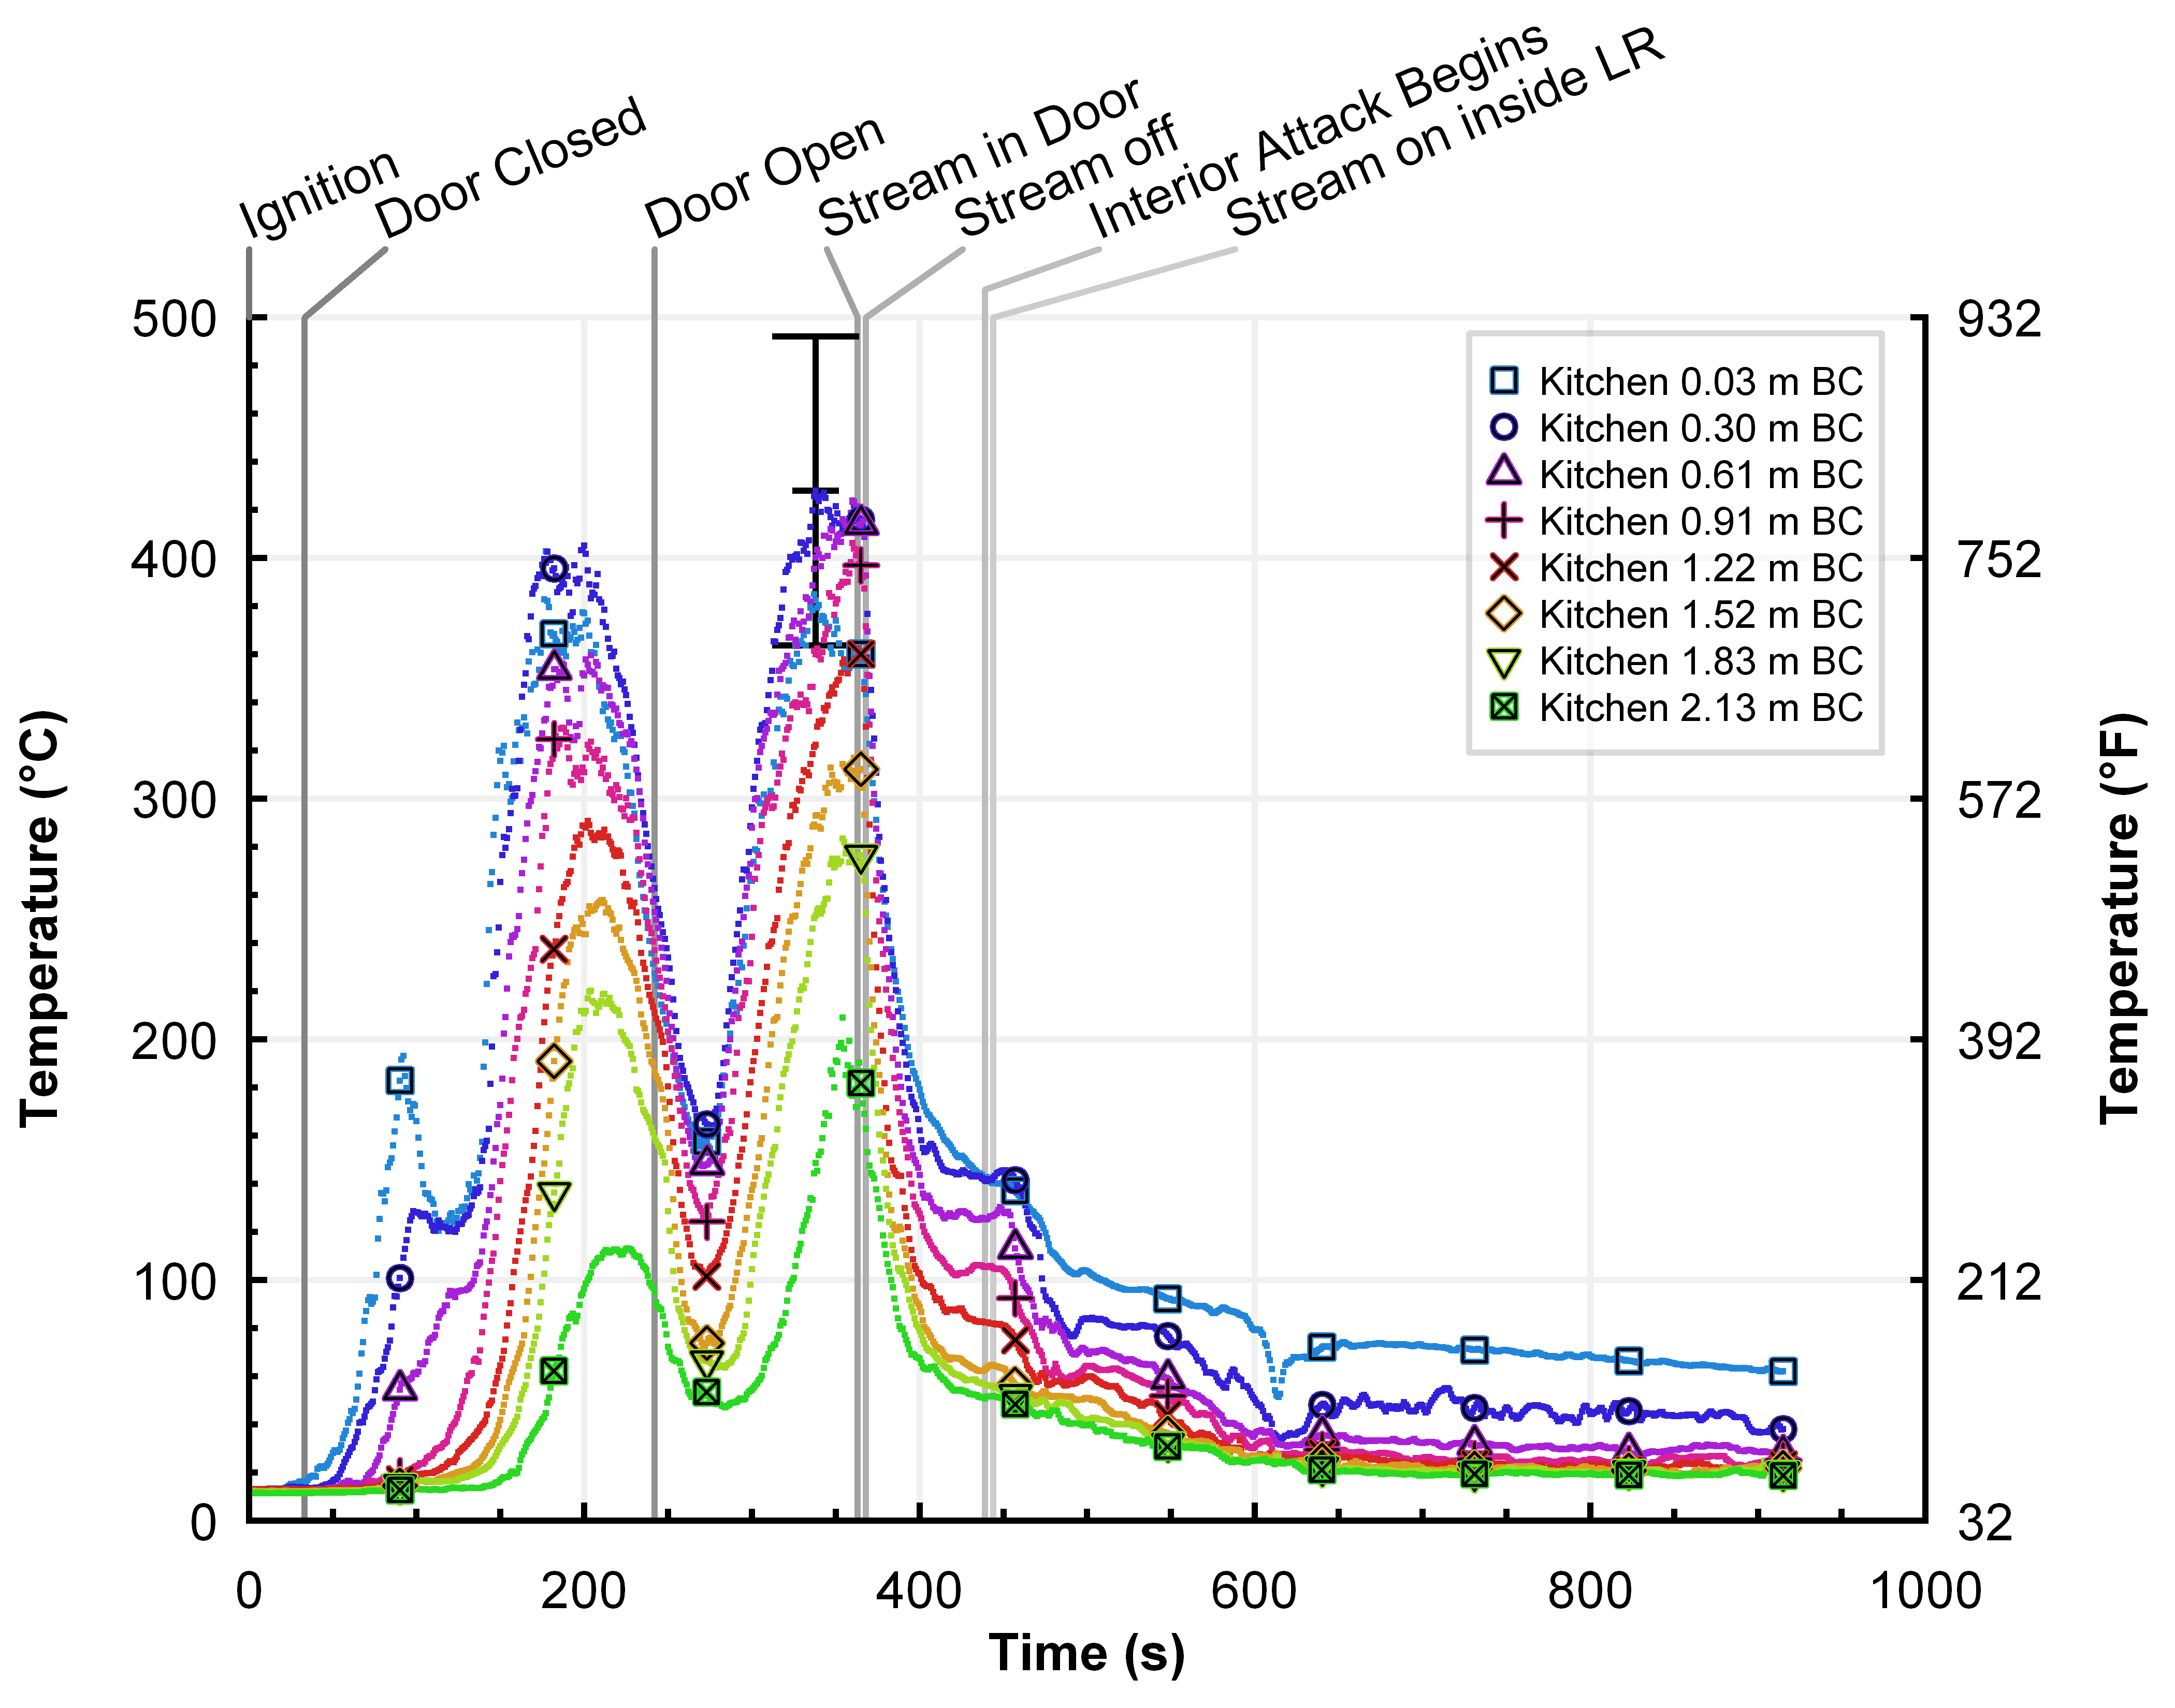
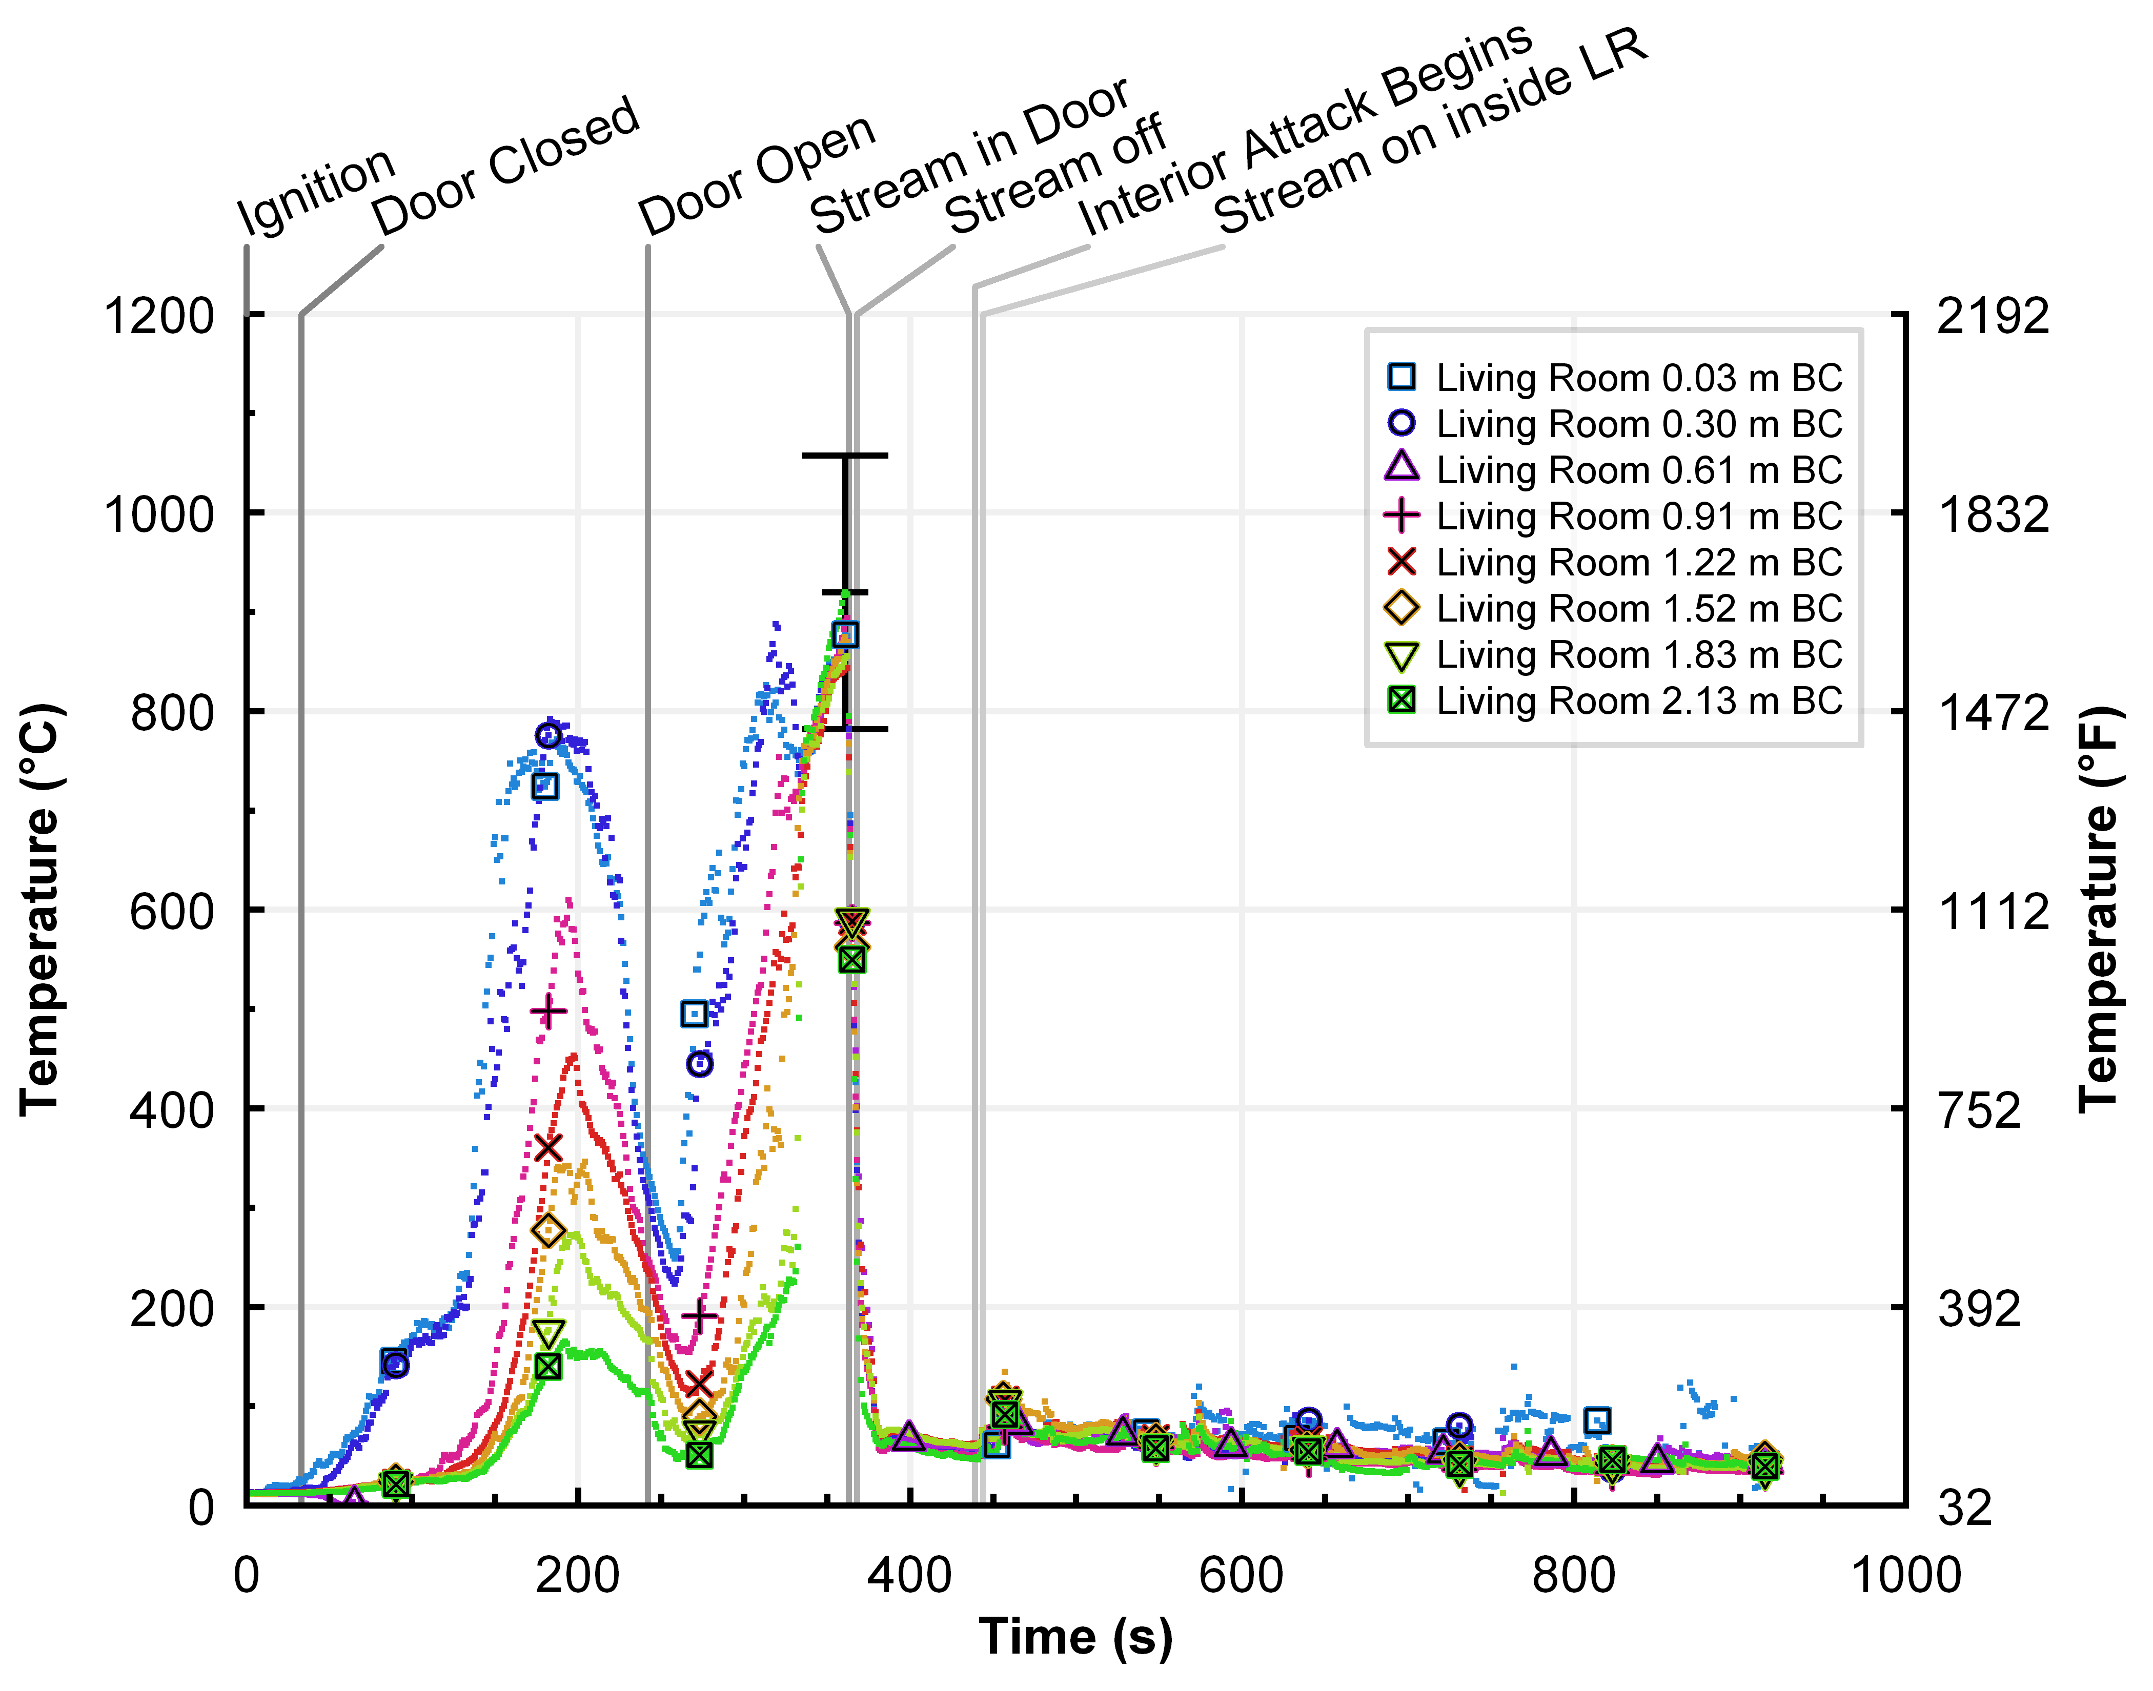

Slide 21
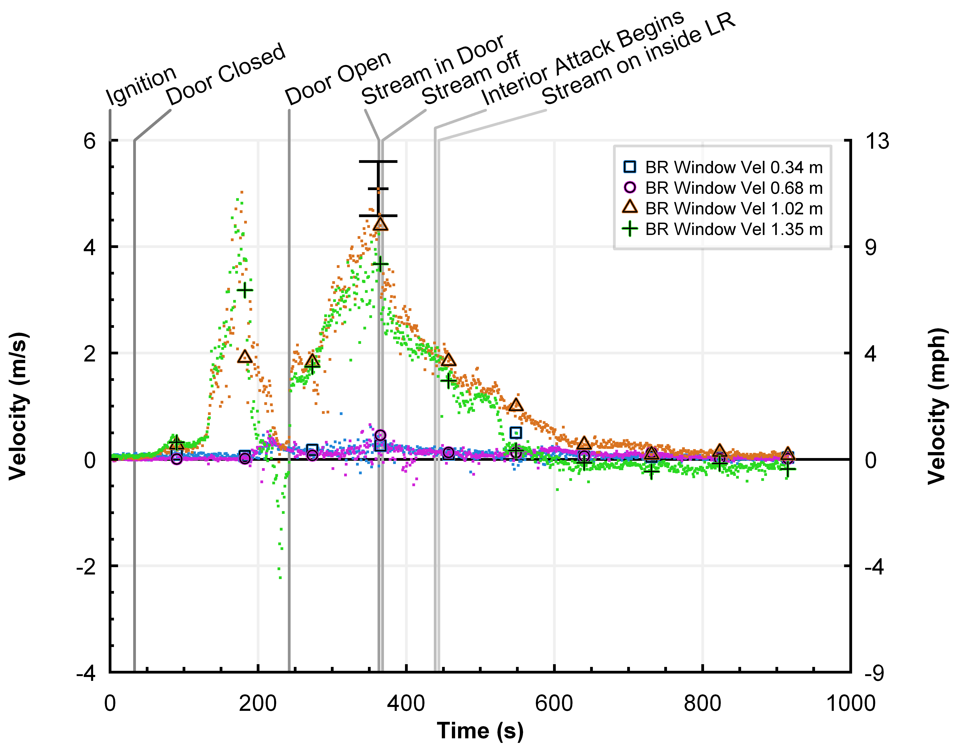

Slide 22
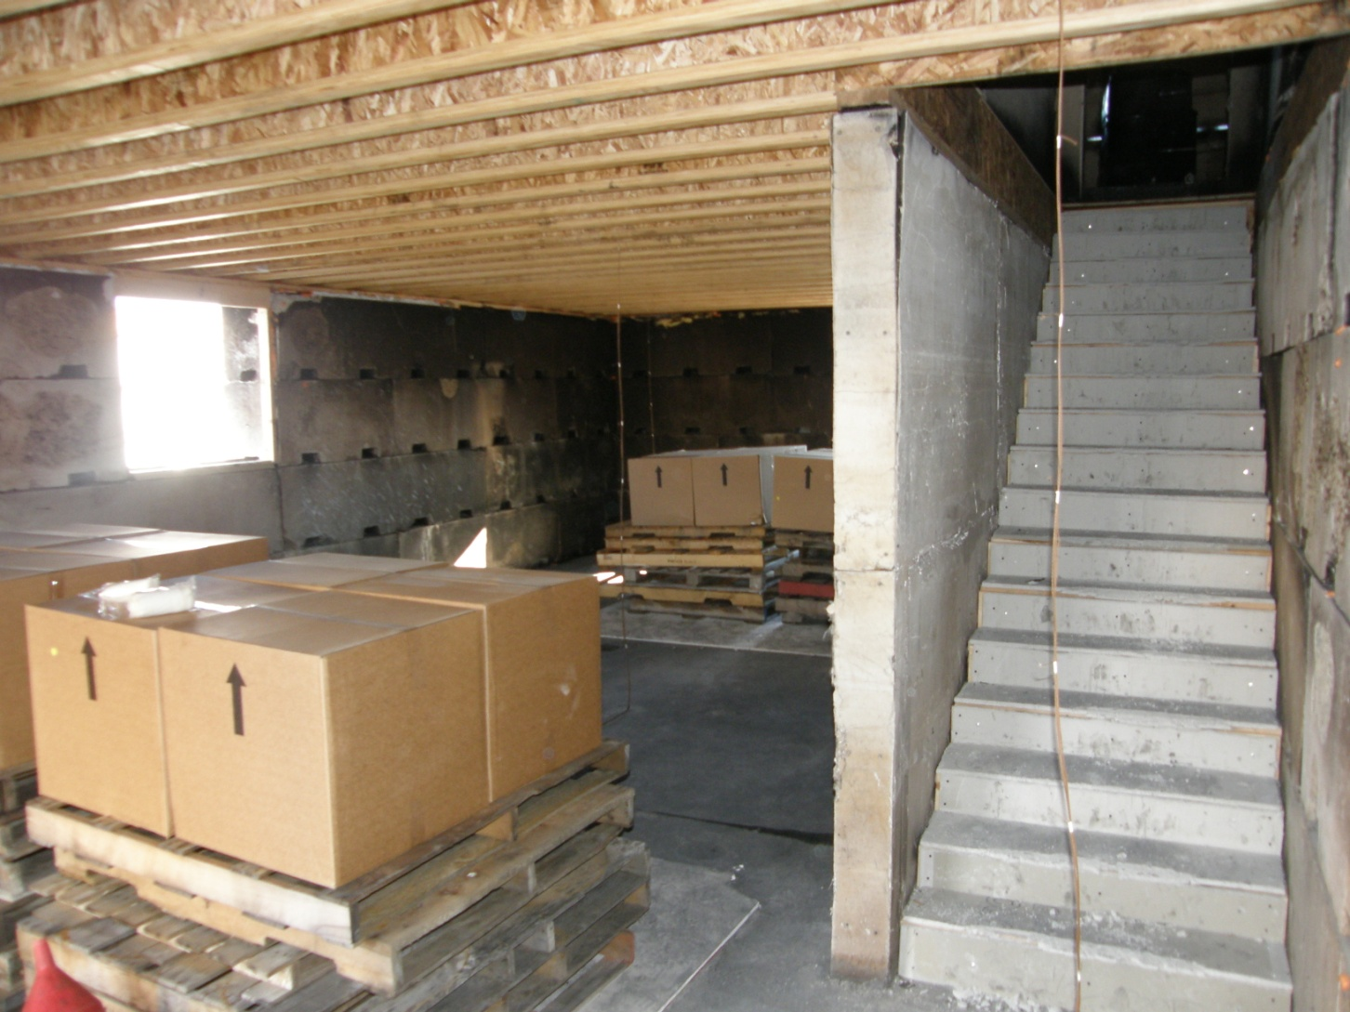
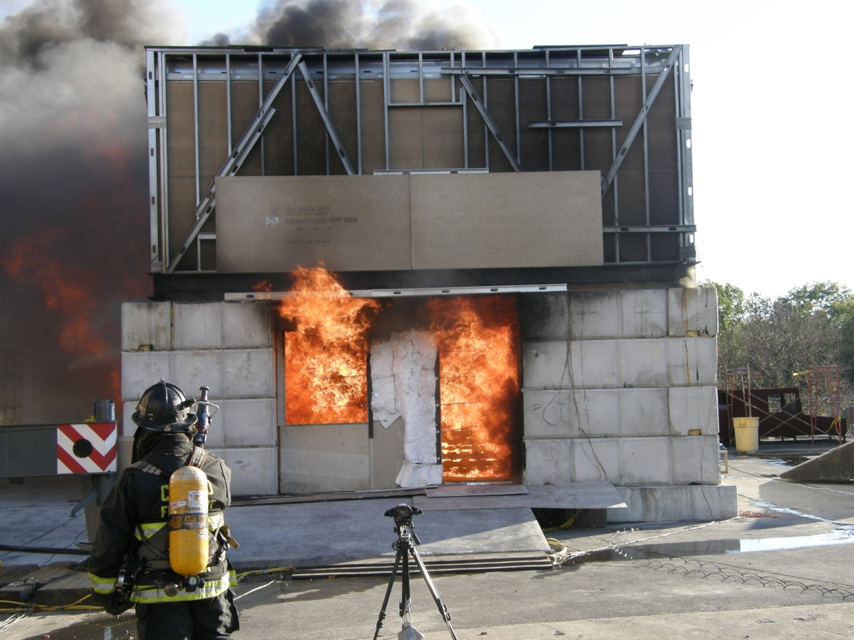

Slide 23
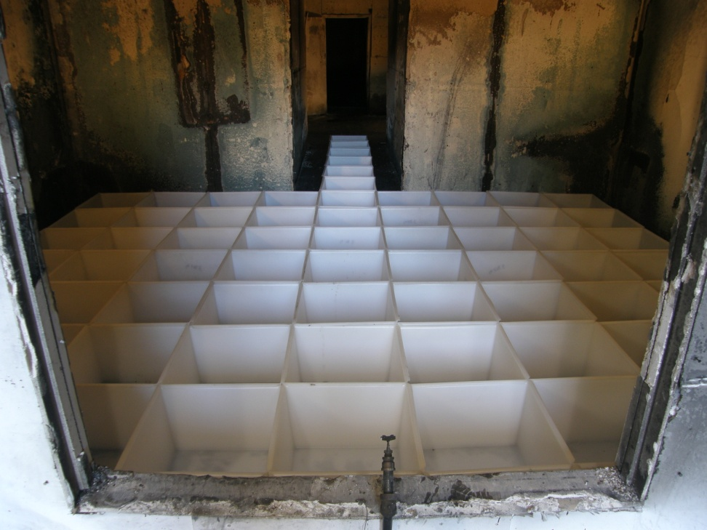
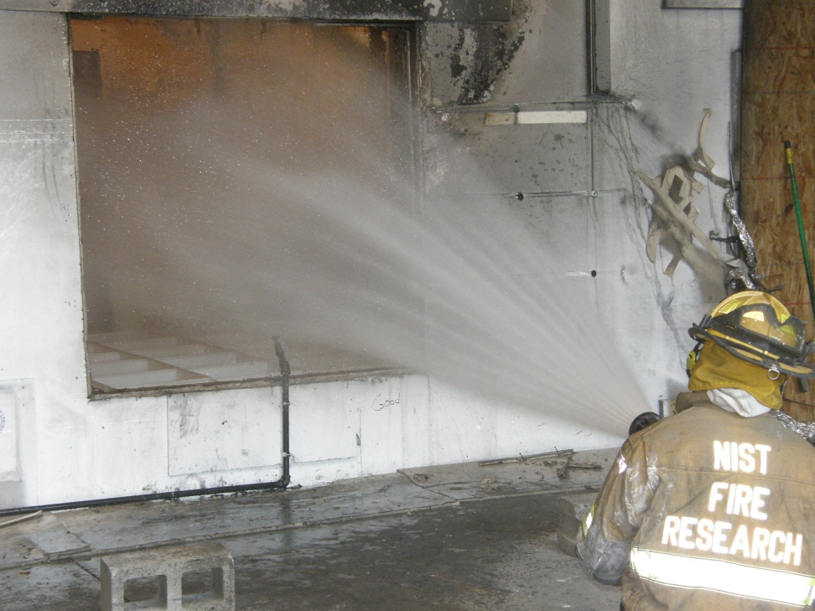
Spray Density/Area of Influence

